Slide 1
Day 1
FInish trends, a little time to work on EA questions on trends sheet
Then this quantum start, time to read quantum sheet OR its homework, come ready to summarize tomorrow.

Slide 2
GET WHITEBOARDS - Front of the class as always

Slide 3
From B-R to Quantum Model
Recall the equation for number of electrons in a B-R energy level
2n²
Using this, draw Ca (think, how many go into the third orbital)
Recall other difficulties with the B-R model!
Notes:
Should see that Ca does NOT have two outer electrons as the third level holds 18 so you just keep adding and Ca only has 3 levels
Other problems: B-R energy levels only explain spectra of hydrogen, glitches in the ionization energy trend (Be and N)

Slide 4
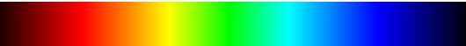
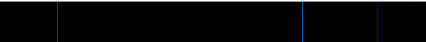
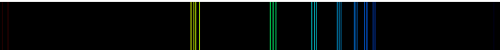
White Light
Hydrogen
Potassium
Explain the multiple lines of nearly identical colours!
Notes:
Without looking at Quantum notes, consider the B-R model of energy levels with quantas of energy yeilding specific colours when electron moves between them. How could you account for the multiple lines of very similar colours (energy amounts) in potassium (grps of 3 -4)? – suggests there are multiple levels with very similar but slightly different amounts of energy.

Slide 5
Read & Think
Read over the handout and attempt to summarize to your partner

Slide 6
Day 2

Slide 7
Sub-levels and Orbitals
Quantum and detecting explosives
Quantum dots and cancer surgery
Notes:
Play video on uses of quantum knowlegde (short 5 minutes, using VSEPR theory to design explosives detector

Slide 8
The Quantum Model
Bohr’s model was only the first step in the development of the quantum model of the atom.
Over the course of the first half of the 20th century, the model was further refined to more precisely explain the position and behaviour of electrons in an atom
Notes:
Check my own quantum teaching notes
Demos: balloon with penny, can go around in orbit like Bohr or bound around in the space like quantum.

Slide 9
Features of The Quantum Atom
There are major energy levels (also called orbits or shells), similar to Bohr-Rutherford model. Major levels are represented by “n” and can contain a maximum number of electrons (2n²).
Energy levels have overlapping subshells that are divided into 4 different types (s, p, d and f), based on the maximum number of orbitals (and electrons) they can have. (note that lower energy levels do not have all 4 types of subshells)

Slide 10
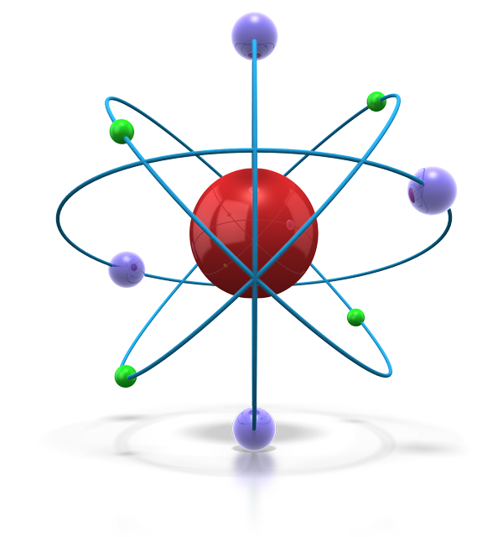
Sub-levels
level = distance from nucleus based on average energy
sub-level = region in a level where there is a high probability of finding an electron
since sub-levels can only hold 2 electrons, 2 must represent a maximum
so how does this relate to p, d and f?

Slide 11
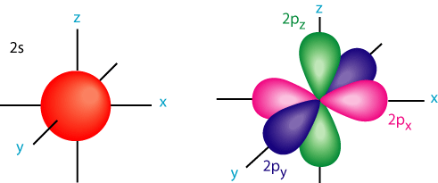
Orbitals
so p sub-level places 2 electrons in its 3 orientations (2 = maximum for any orbital)
basically, the orbital = how an electron moves in space at a location
so s and p are really:
Explains closely spaced spectral lines! Movement between subshells that are close in energy

Slide 12
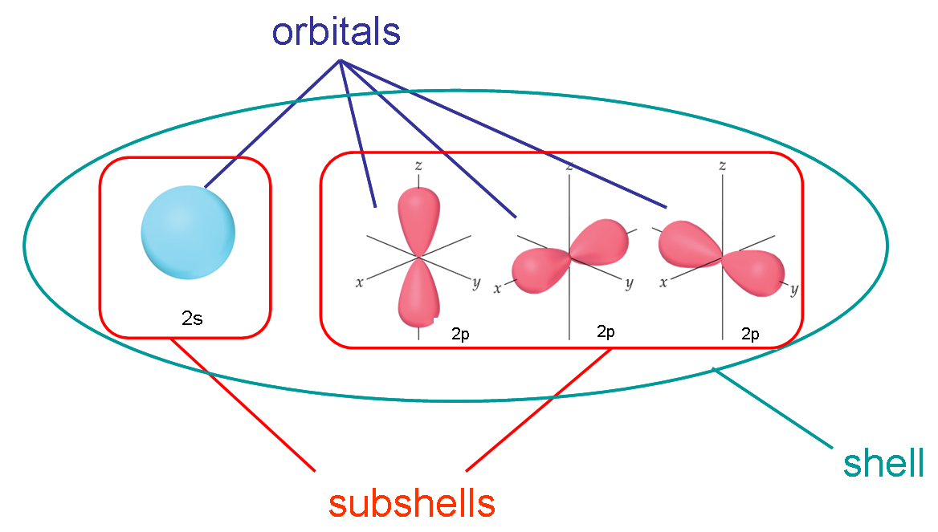
Another Visualization of it

Slide 13
Quantum Numbers
Chemists use Electron Energy Level Diagrams to describe the arrangement of electrons around an atom.
These diagrams indicate which orbital energy levels are occupied by electrons for a particular ion or atom.
Energy level Subshells are divided into 4 different types, based on the maximum number of orbitals they can have. Orbitals can hold 2 electrons each.
Sublevel | Number of Orbitals | Maximum number of electrons
s | 1 | 2
p | 3 | 6
d | 5 | 10
f | 7 | 14

Slide 14
Blocks on the Periodic Table
As it turns out, these sublevels are related to blocks on the periodic table.
Complete the following table using the periodic table on the next slide
Sublevel (aka Block) | Columns of associated elements | Elements found in this “Block”
s
p
d
f

Slide 15
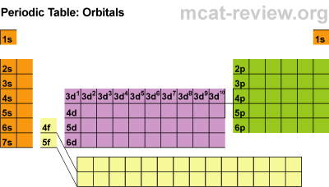
Blocks on the Periodic Table

Slide 16
Blocks on the Periodic Table
As it turns out, these sublevels are related to blocks on the periodic table.
Complete the following table using the periodic table on the next slide
Sublevel (aka Block) | Columns of associated elements | Elements found in this “Block”
s | 1 & 2 | Alkali & alkaline metals
p | 3-8 | Non-metals mostly
d | 3-12 (don’t confuse with above) | Transition Metals
f |  | lanthanides/actinides

Slide 17
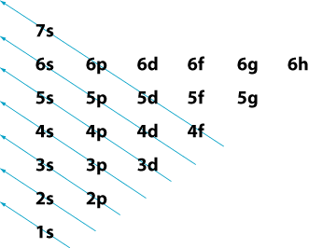
An “aufbau” mnemonic
This memory aid shows the order of the orbitals as they are filled with electrons:
Notes:
Have them compare this to periodic table., match up to major blocks on table.

Slide 18
Electron Configuration Notation

Slide 19
What is it?
Drawing pictures of the quantum model is simply too complex.
Electron configuration notation is just another way to describe where the electrons are located.
It is a list of all the electrons in an atom

Slide 20
Determining an electron configuration
Use the position on the periodic table
Period number = highest level of the atom

Slide 21
The Rules
The first number indicates the principal quantum number
The superscript number indicates the number of electrons in that subshell
NOT to be confused with an exponent.
3s²
The letter indicates the subshell (secondary quantum number)

Slide 22
Example: Chlorine
Cl atom contains 17 electrons.
Start building:
1s²2s²p⁶3s²p⁵
Only write the principal quantum number once

Slide 23
NOTE: there is a video reviewing quantum atom on the unit plan. This is great for review at home to clear up any confusions.

Slide 24
Subshell order
Subshells of the same primary quantum number must be kept together even though they may fill in a different order.
Example: zinc (period 4, group 12)
1s²2s²p⁶3s²p⁶d¹⁰4s²
3d fills after 4s, however it is not written in that order

Slide 25
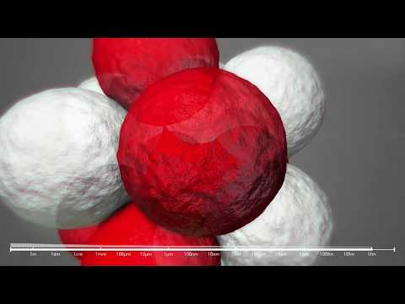
3 Minute voyage into an atom

Slide 26
STOP HERE FOR TODAY

Slide 27
Day 2 Quantum Bellwork
On your whiteboards, write the electron configurations for:
Be
S
Cr
Leave all three on your board for use in shortcut method we’re going to learn.

Slide 28
Let’s save time:
NOBLE GAS shortcut:
1. Find the noble gas at one period below on the periodic table.
2. Start your notation by writing the noble gas symbol in square brackets: [__]
3. Continue the electron configuration from there.

Slide 29
Example: Yttrium
Find the noble gas
[Kr]
2. Start writing the electron configuration:
Yttrium is in group 3 and period 5
[Kr] 4d¹5s²
See Quantum Review Video on website

Slide 30
Day 3

Slide 31
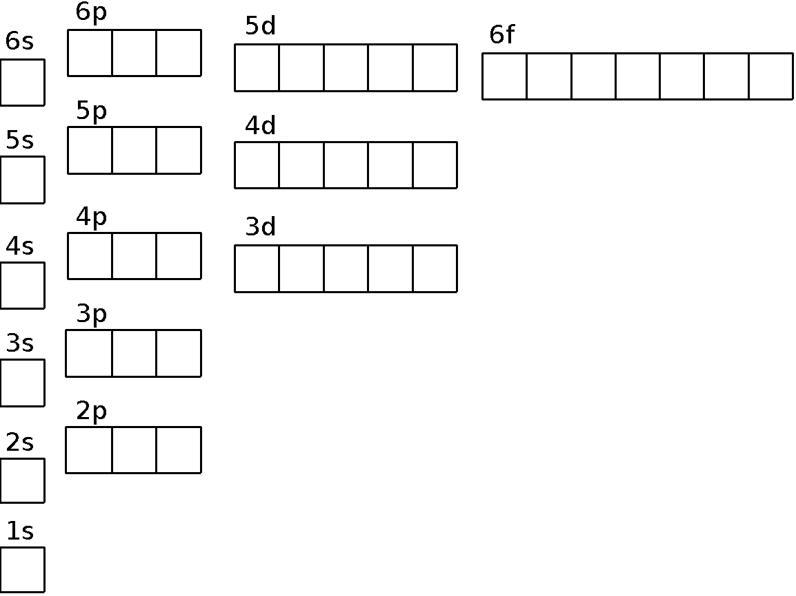
Example Energy Level Diagram:
Example: Barium Atom | Electrons are placed in these diagrams following these rules:
 | The aufbau principle: Electrons always fill lower energy levels before moving to higher energy orbitals.
 | Hund’s Rule: Electrons are filled into empty orbitals so that each orbital gets one electron before you start doubling up.
 | Pauli Exclusion Principle: No two electrons can be in the same place at the same time. This means that electrons in the same orbital spin in opposite directions and are indicated with arrows in different directions.

Slide 32
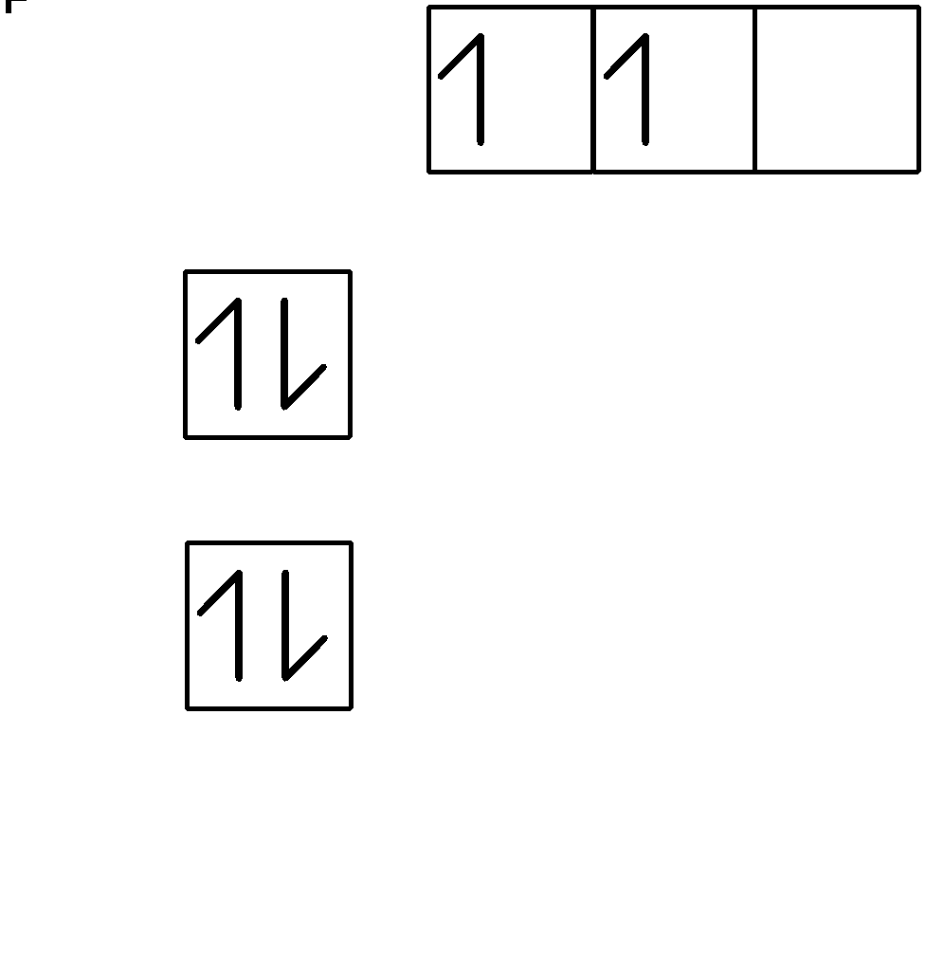
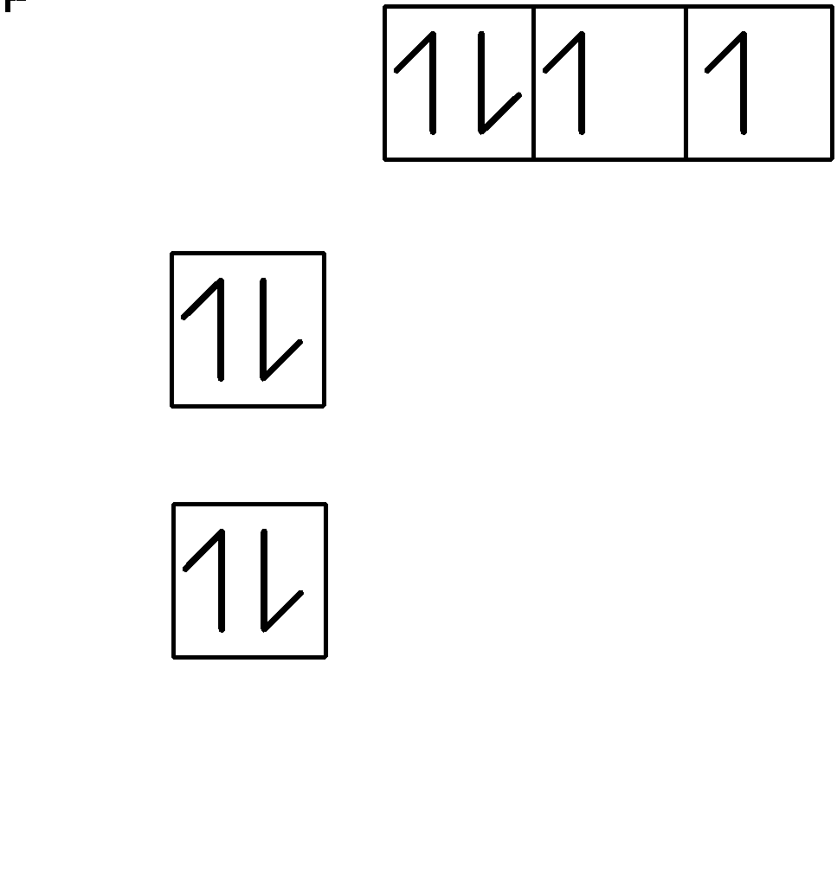
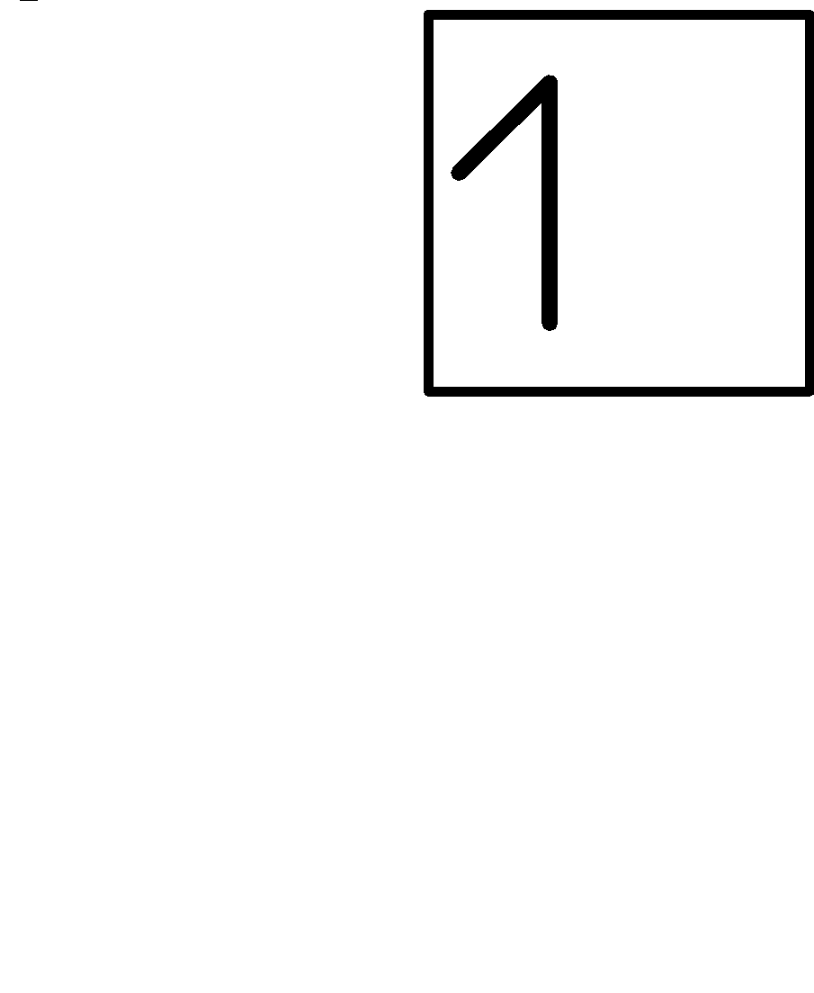
Energy Level Diagrams
draw H, C and O
note energy increases moving up and note spacing/labelling
2
1
S
S
p
s
p

Slide 33
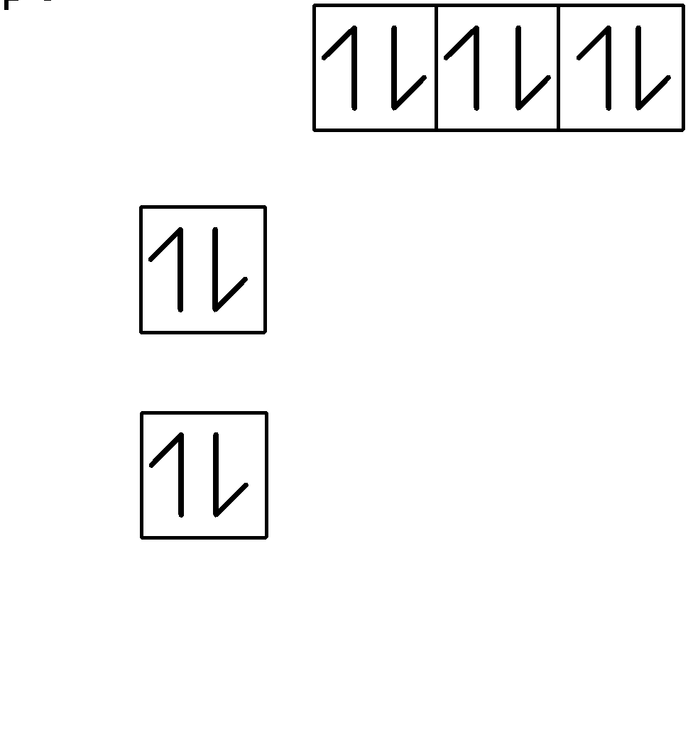
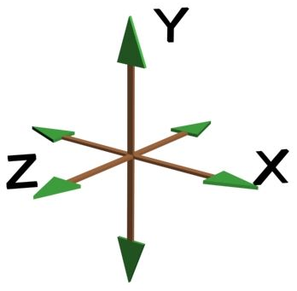
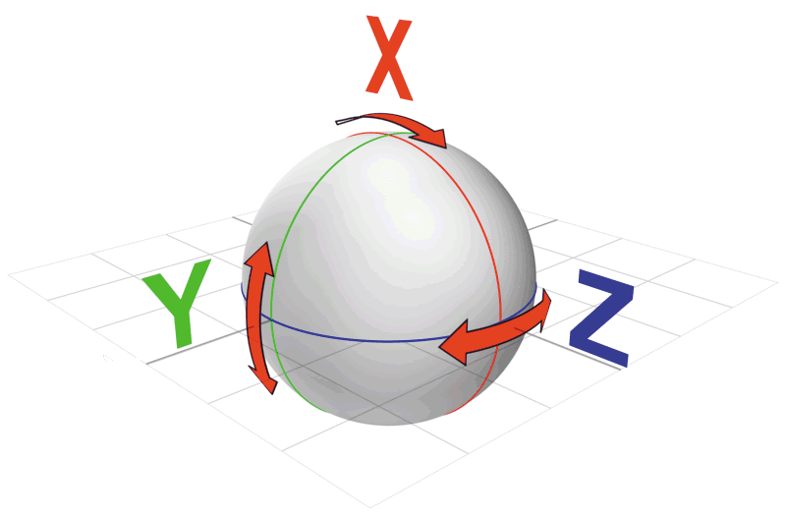

try He and Ne
so stability means full orbitals as this cancels magnetic forces created by spinning electrons in all directions
2
1
s
s
p

Slide 34



try Be and N
2
1
s
s
p
see partial stability created as incomplete filling but magnetic forces are balanced in all directions due to rapid motion

Slide 35
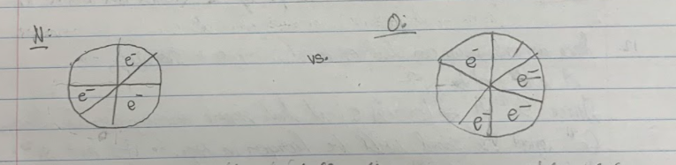
Another way of visualizing the partial stability balance

Slide 36
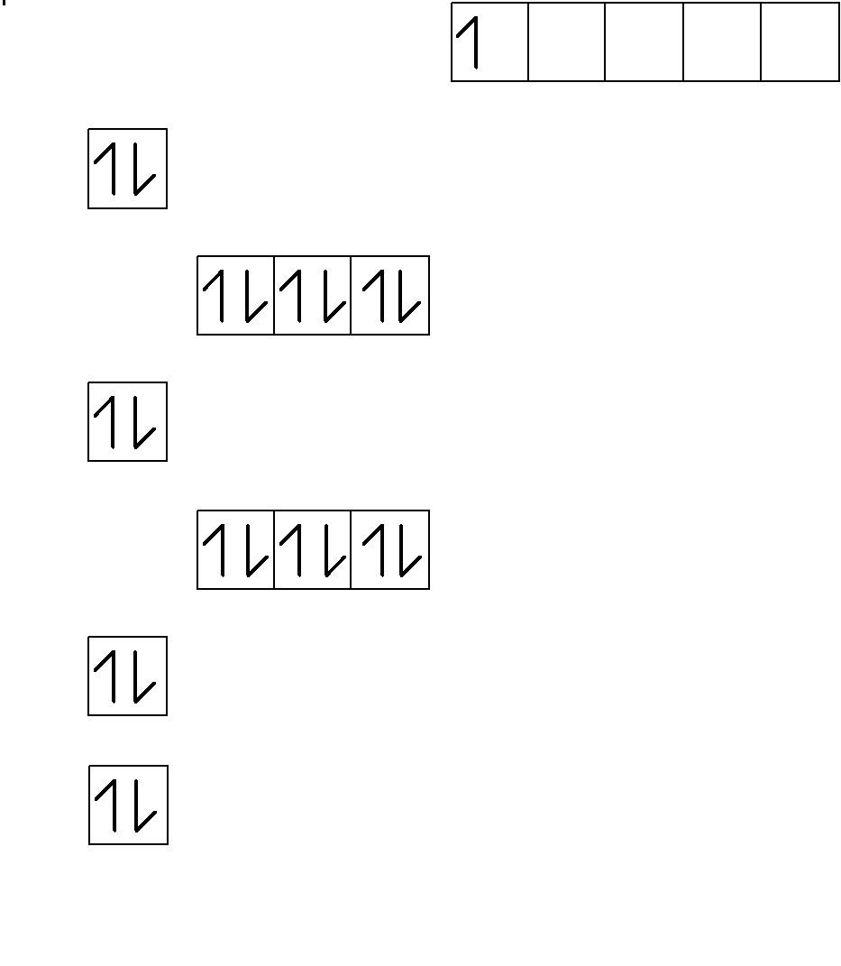
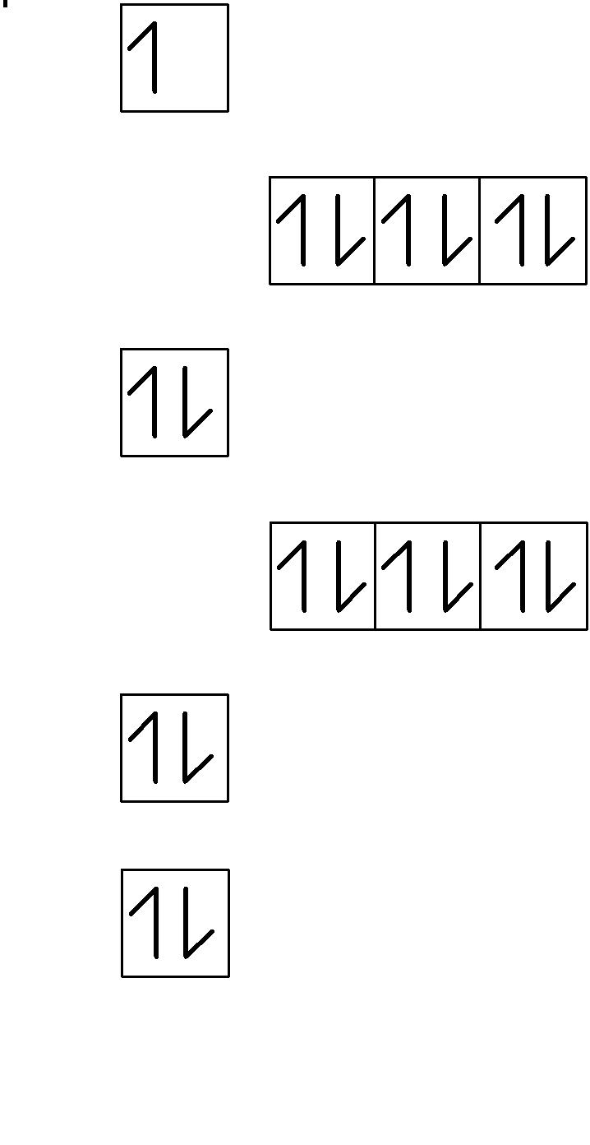
try K and Sc
3d
4
3
2
1
s
s
p
d
p

Slide 37
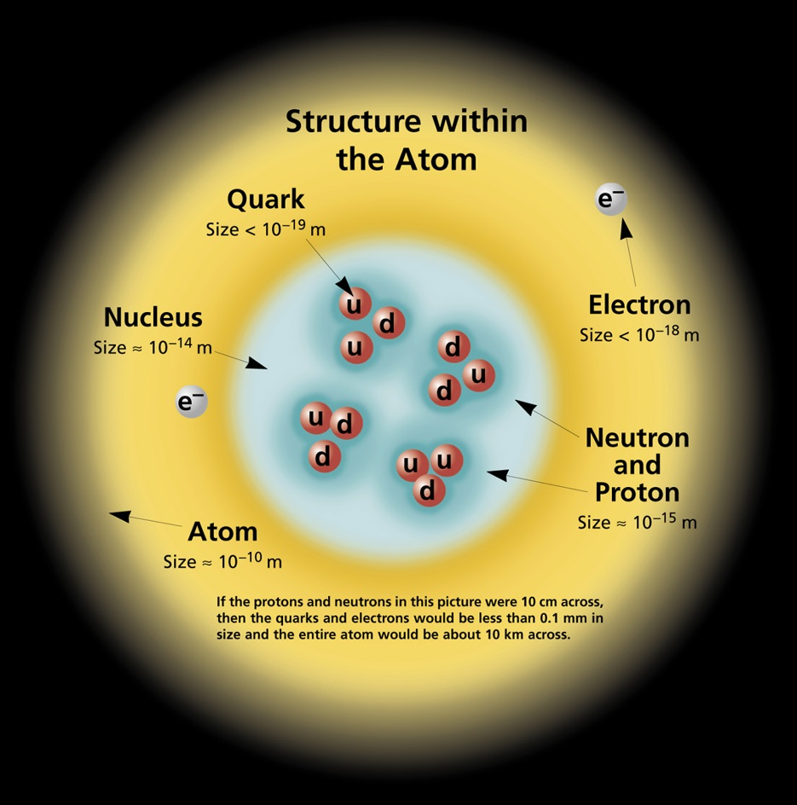
now all the anomalies can be explained
except why protons can’t repel within the nucleus

Slide 38
Extra Notes
When EMPTY the 3d orbital is higher energy than the 4s, so electrons are in 4s before 3d. Once electrons are IN the 3d orbital, they ARE closer average distance to the nucleus than 4s AND then push the 4s level further away by repulsion resulting in those electrons having a higher energy than 3d.

Slide 39
Quantum Battleship - one partner should know regular Battleship rules :)
ON YOUR TABLE: STAY IN TOP 5 PERIODS
- NO crossing lines, NO diagonals
-ONE 5 element lines
- TWO 4 element lines
- ONE 2 element line
- COMPLETE FULL configurations for all elements (can line them up and “reuse” parts of above
TO PLAY: Guess locations using the noble gas shortcuts. Confirm partners guesses by stating the matching element. Once confirmed, if its a HIT let them know and mark it.

Slide 40
Quantum and Per Table Trends
Cover partial stability and electron promotion (4s → 3d)
Notes:
See zubers student and teacher’s notes

